Slide 1
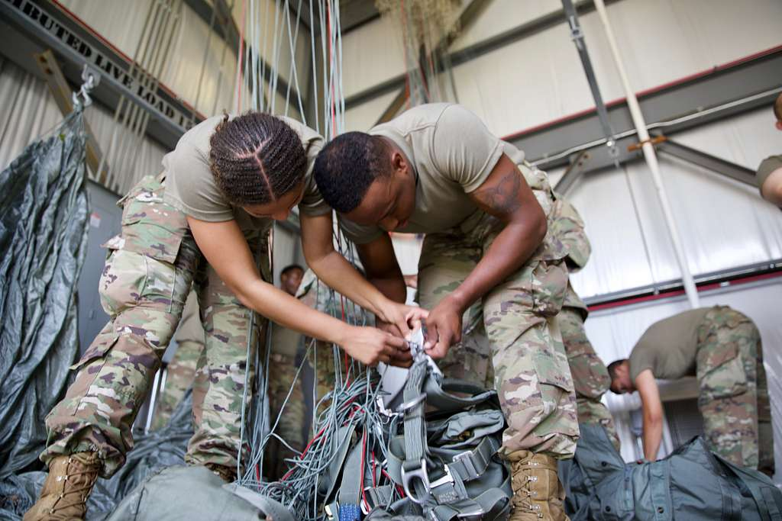
Who should pack your parachute
Parachute riggers train to ensure that the parachute will open when needed.

Slide 2
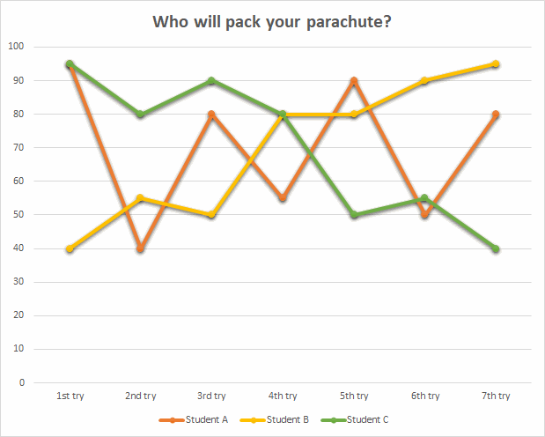
Let’s look at three students’ scores
What can you say about the quality of the three riggers’ skills.
Can you decide who you’d chose?

Slide 3
Let’s look at three students’ scores
Maybe we should look at the averages…

Slide 4
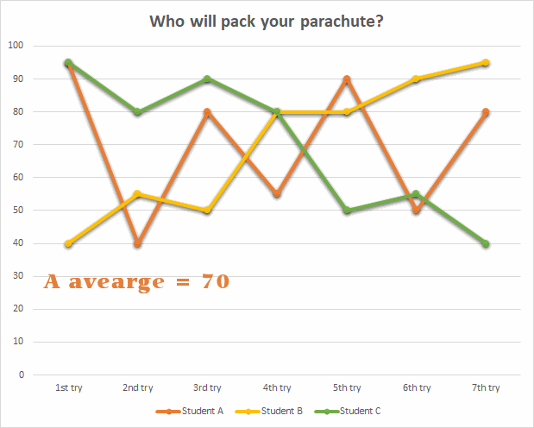
Let’s look at three students’ scores
Student A has an average score of 70.

Slide 5
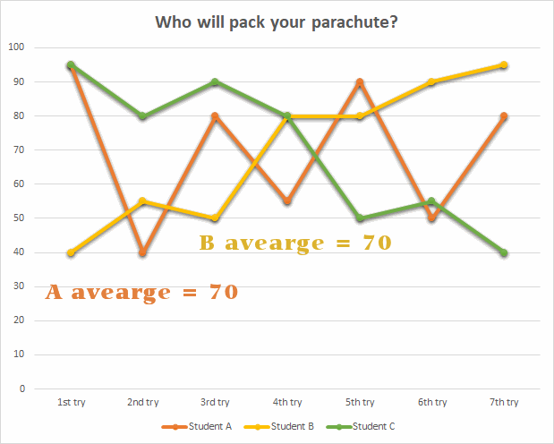
Let’s look at three students’ scores
Student A has an average score of 70.
So does Student B.

Slide 6
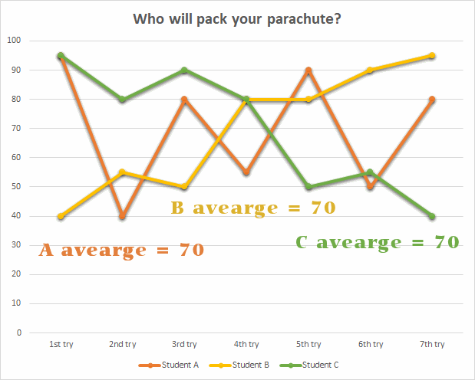
Let’s look at three students’ scores
Student A has an average score of 70.
So does Student B.
Wow, so does Student C.

Slide 7
Maybe we need a different system than averaging

Slide 8
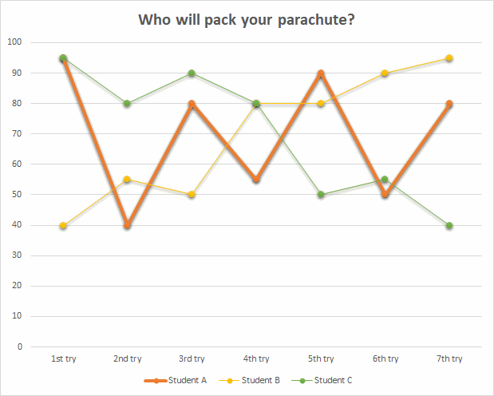
Looking at trends
Here’s a focus on Student A.
How would you describe the trend of Student A?

Slide 9
Looking at trends
Could we say that Student A is inconsistent, and doesn’t seem to be improving?

Slide 10
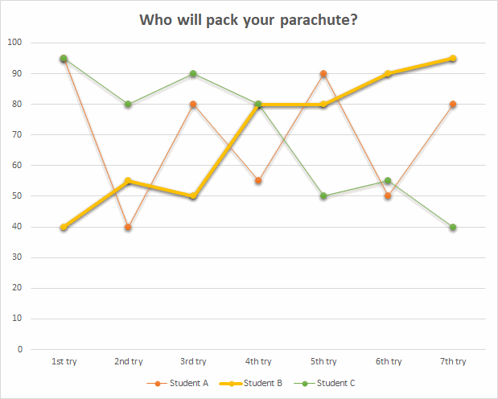
Looking at trends
Here’s a focus on Student B.
How would you describe the trend of Student B?

Slide 11
Looking at trends
Student B started off with a low score but is generally increasing in skill level…and the last four are higher quality.

Slide 12
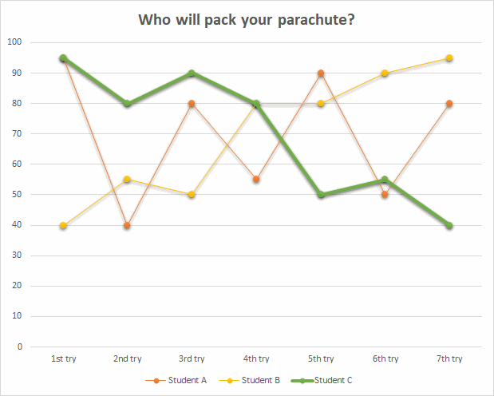
Looking at trends
Here’s a focus on Student C.
How would you describe the trend of Student C?

Slide 13
Looking at trends
Student C started off with a good score, but seems to be doing worse over the seven trials.

Slide 14
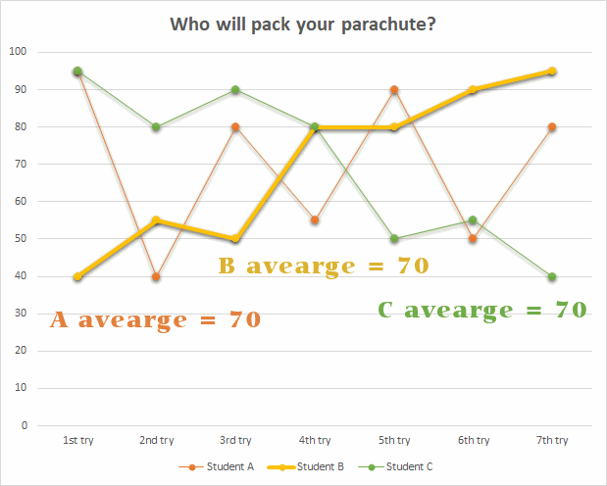
Conclusion
While each student earned the same average, Student B shows consistent growth.

Slide 15
Conclusion
So, who would you chose to pack your parachute?

